Slide 1






Origin Stories and Other Bibliographical Tales
Meaghan J. Brown, CLIR Fellow for Data Curation
  @EpistolaryBrown
  mbrown@folger.edu

Slide 2
Representing Digital Developments

Slide 3
Browsing Beeston’s Boys

Slide 4
Women Beware Women

Slide 6
Women Beware Women

Slide 7
Women Beware Women: DEEP

Slide 8
Women Beware Women

Slide 9
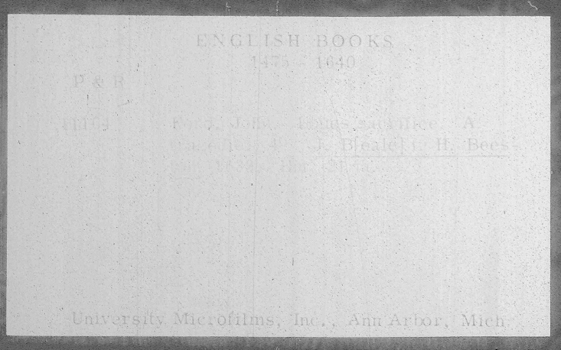
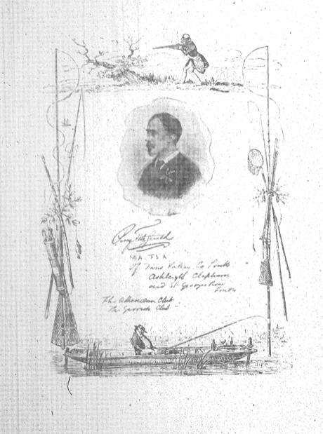
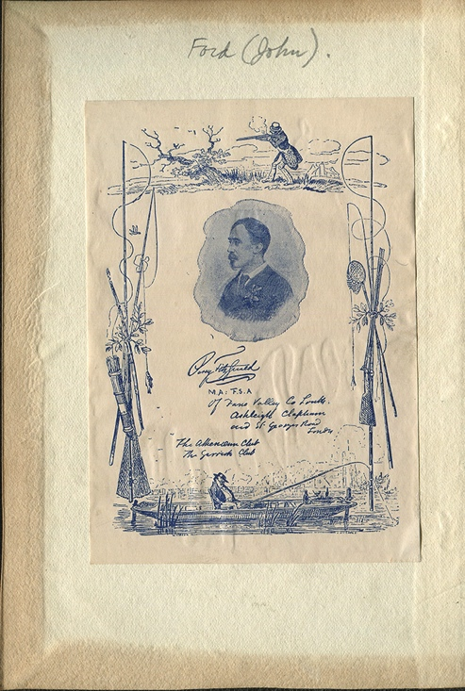
Ford’s Loues Sacrifice (1633)
Original EEB microfilmed record
Microfilmed bookplate
Image courtesy of Wayne Hammond
Item located at the Chapin Library,
Williams College, MA
full story available at collation.folger.edu
EEBO search result and record

Slide 10
Not searchable, but...

Slide 11
The Country Captain

Slide 12
Country Captain Transcript

Slide 13
The Country Captain

