Slide 1
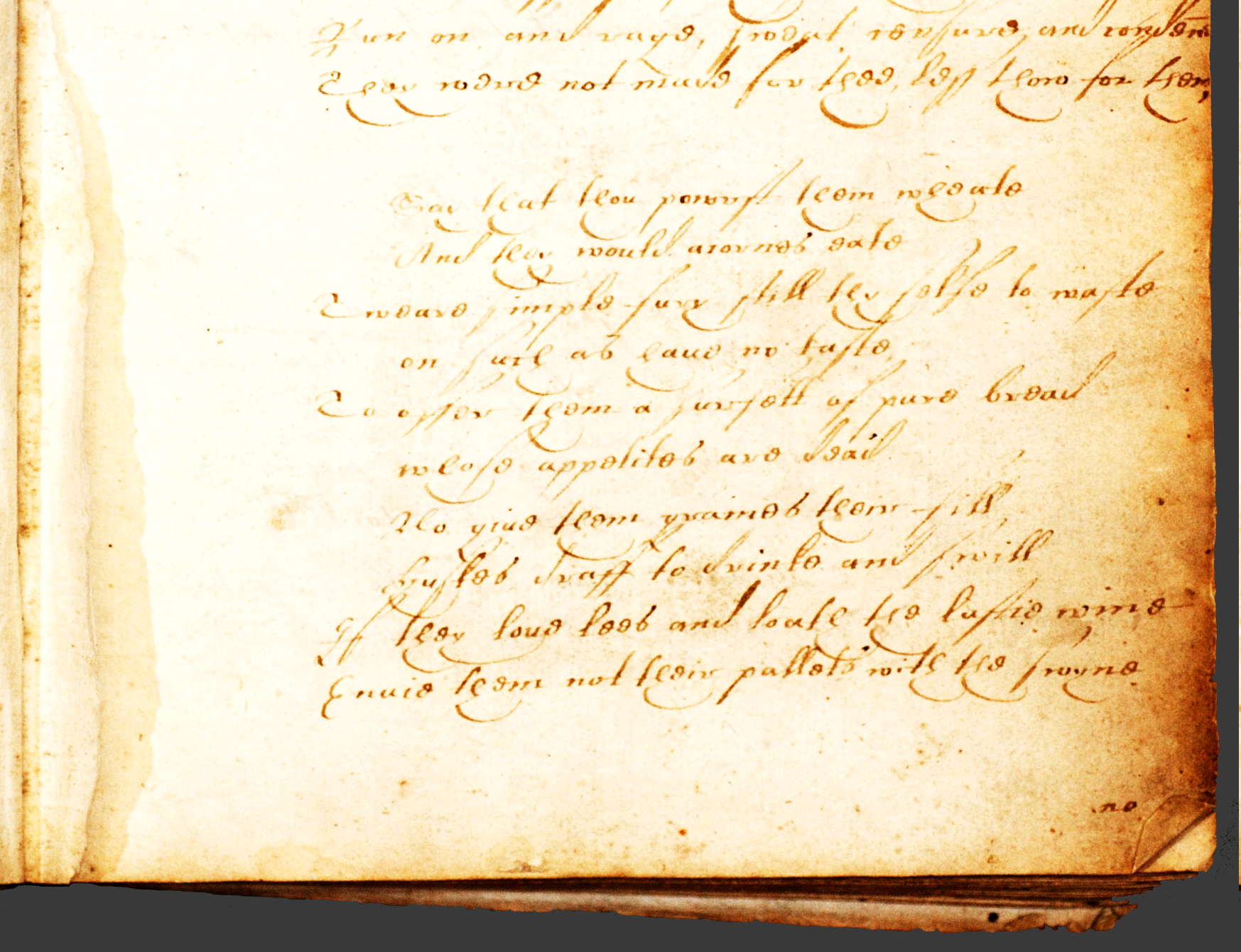
EEBO-TCP:
The Searchable (Print) Text and Manuscript Studies
Laura Estill
lestill@tamu.edu
@Laura_Estill
SAA 2016
New Orleans

Slide 2
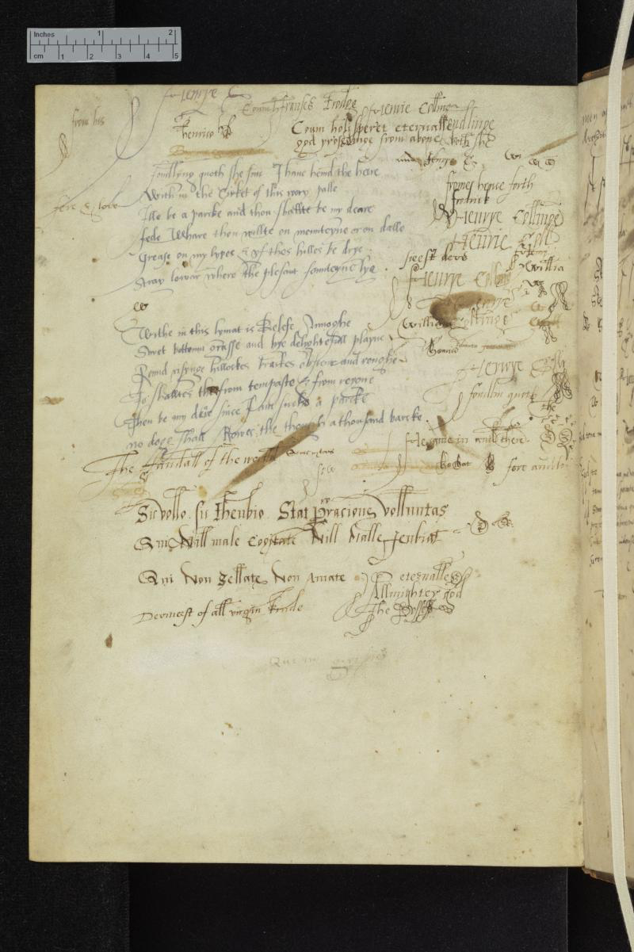
www.shakespearedocumented.org

Slide 3
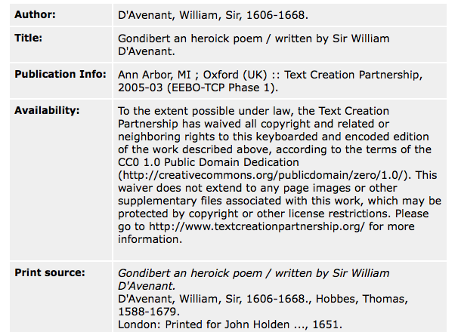
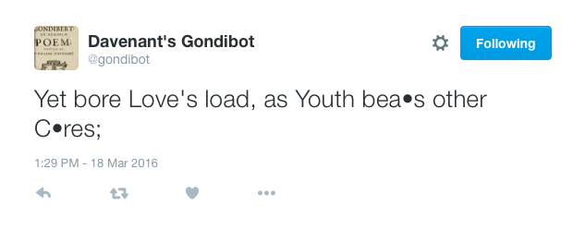

Slide 4
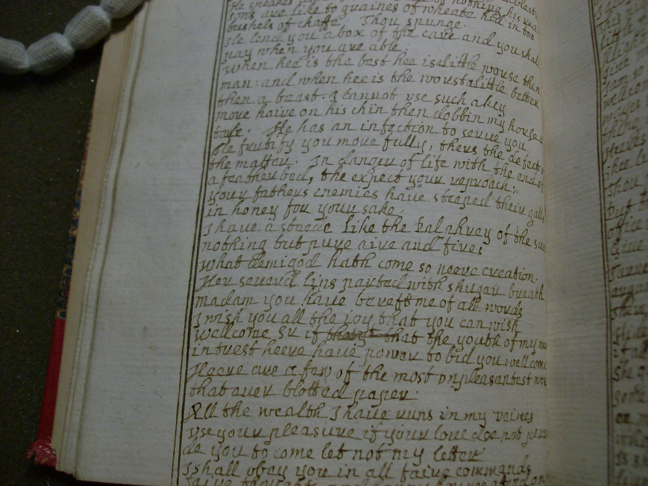

Slide 5
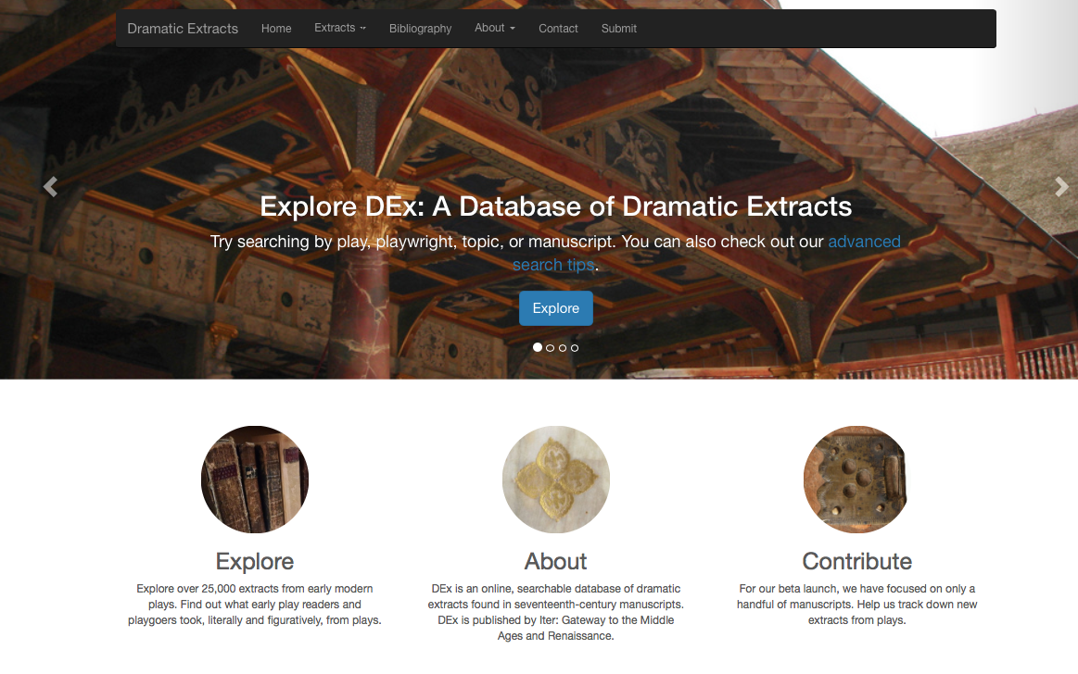

Slide 6
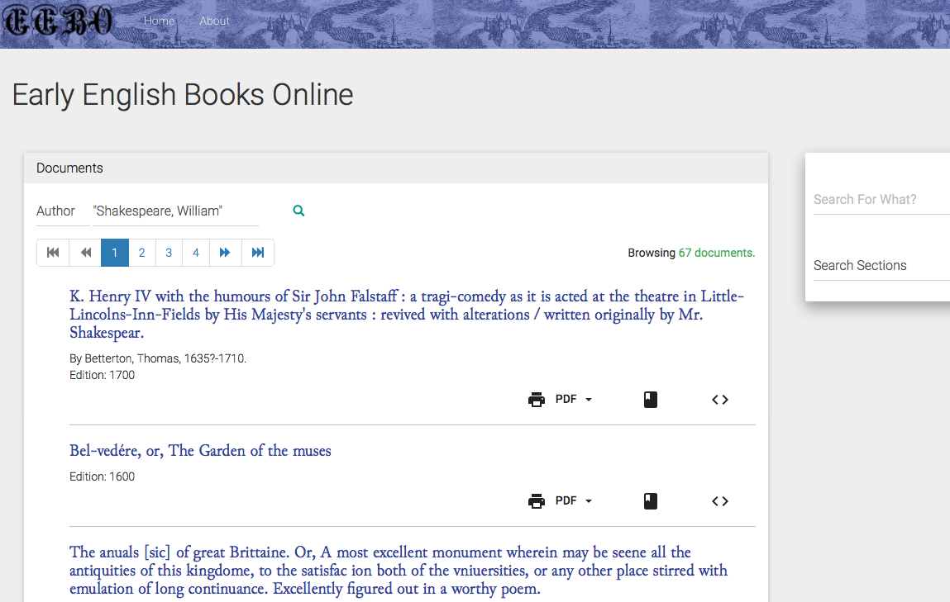
http://showcases.exist-db.org

Slide 7
EEBO-TCP:
The Searchable (Print) Text and Manuscript Studies
Laura Estill
lestill@tamu.edu
@Laura_Estill
SAA 2016
New Orleans

